Slide 1
Transformers+
Based on:
https://jalammar.github.io/illustrated-bert/
https://jalammar.github.io/how-gpt3-works-visualizations-animations/

Slide 2
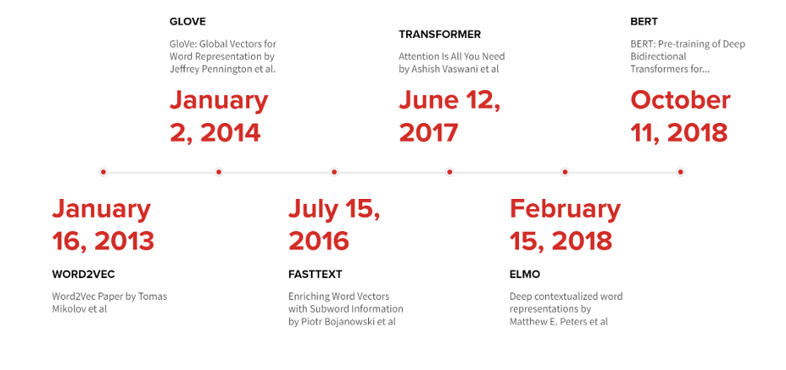
Timeline of some major projects

Slide 3
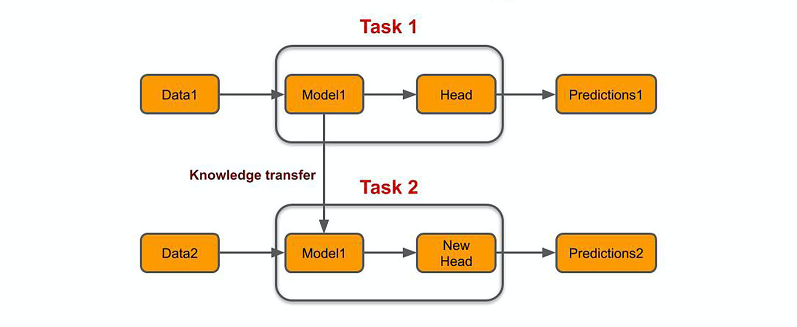
Transfer Learning

Slide 4
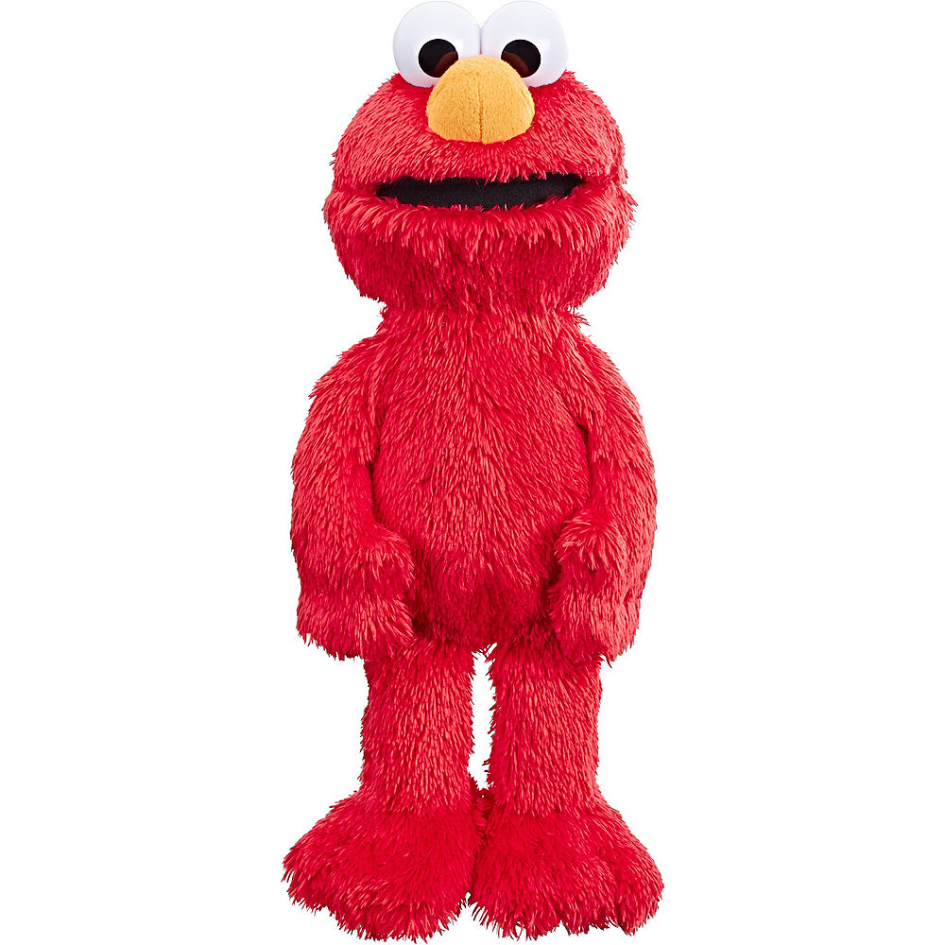
ELMO: Embeddings from Language Models

Slide 5
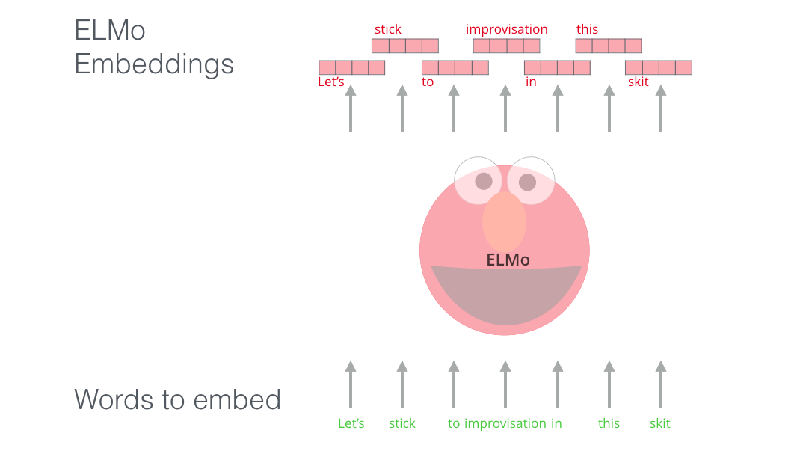
ELMO

Slide 6
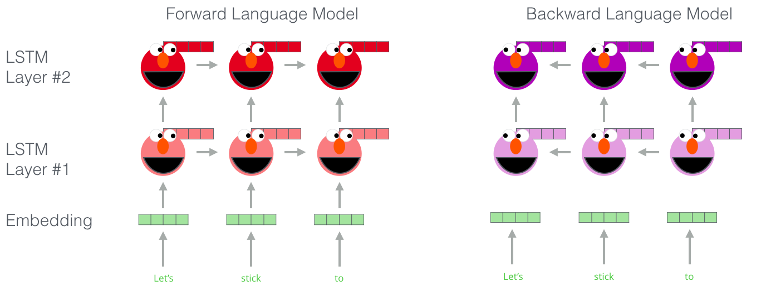
ELMO

Slide 7
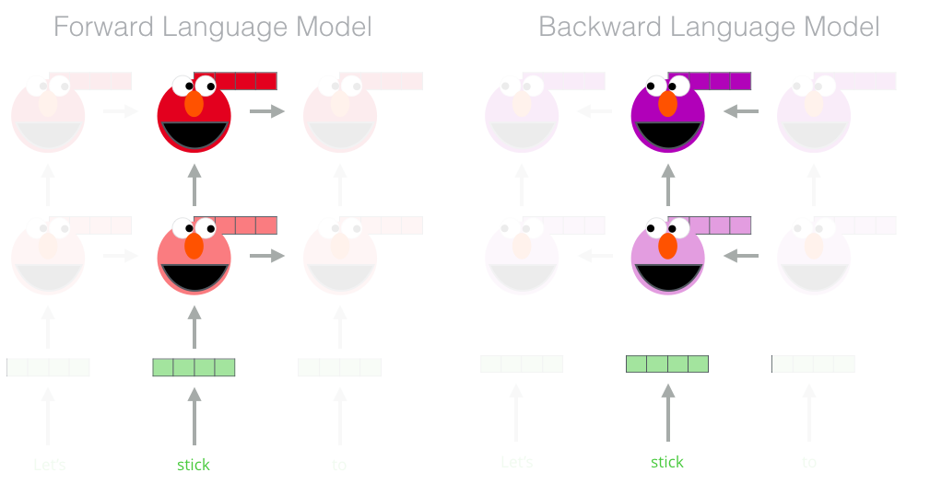
ELMO

Slide 8
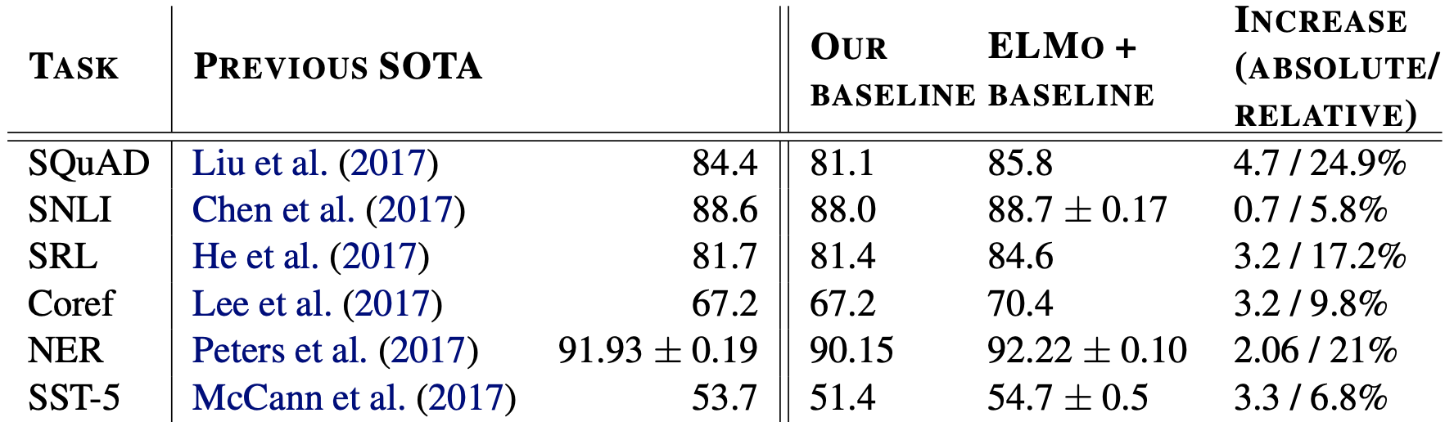
ELMO
Paper link
Elmo weights

Slide 9
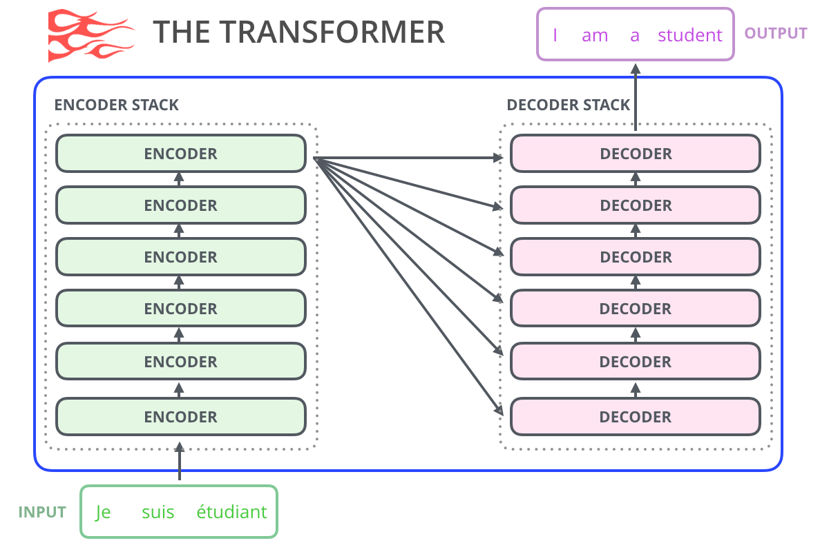
GPT: Generative Pretrained Transformers

Slide 10
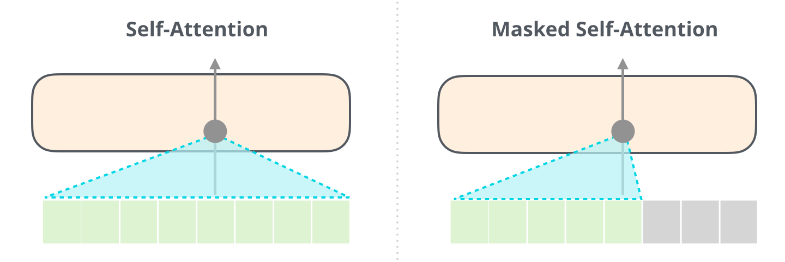
GPT

Slide 11
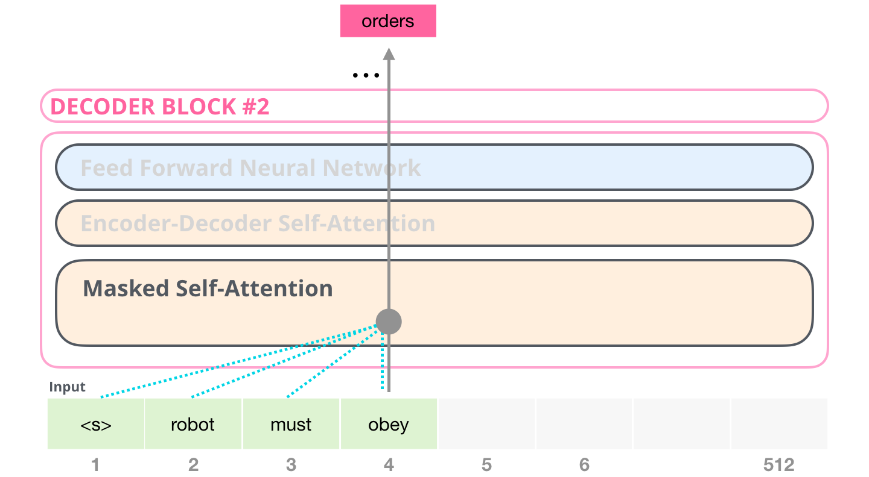
GPT

Slide 12
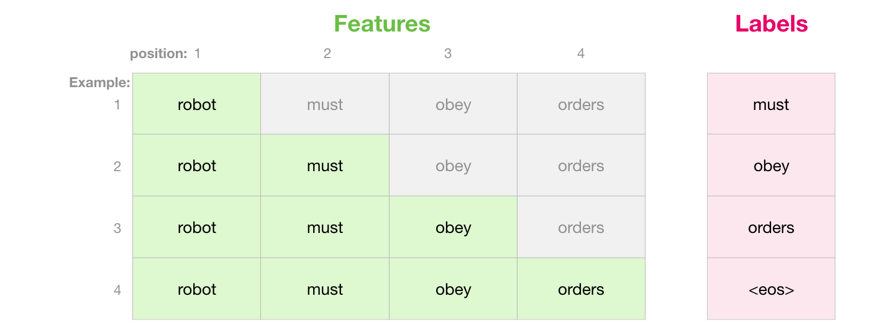
GPT

Slide 13
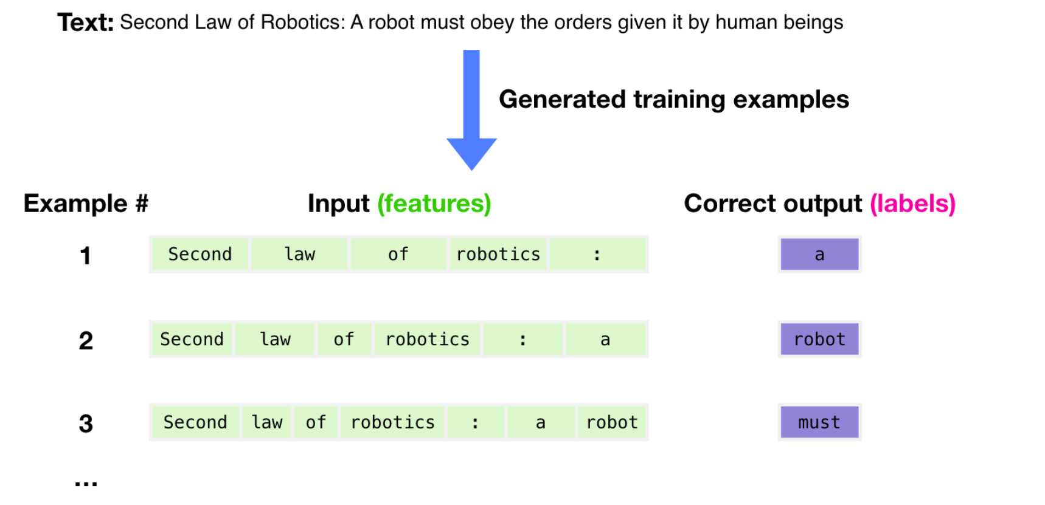
GPT

Slide 14
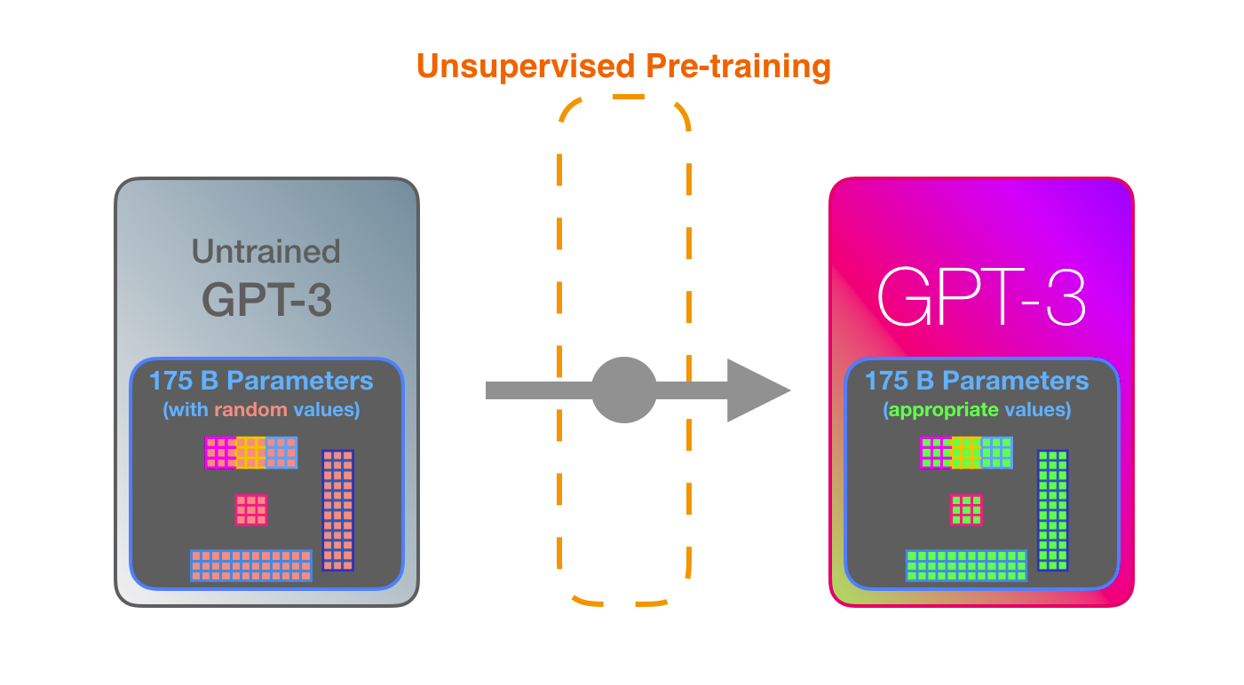
GPT

Slide 15
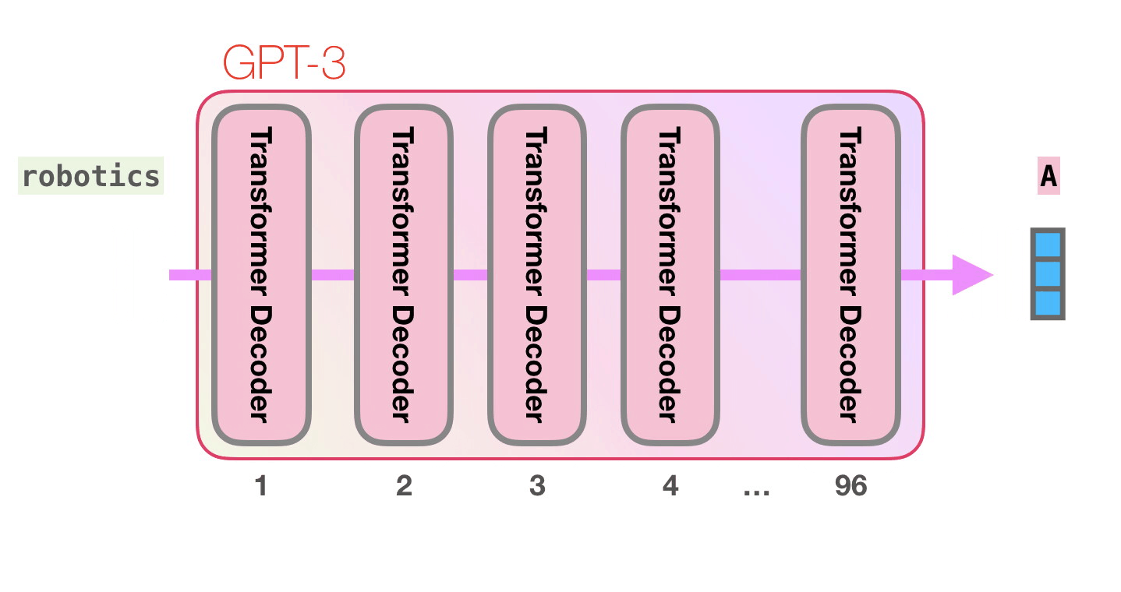
GPT

Slide 16
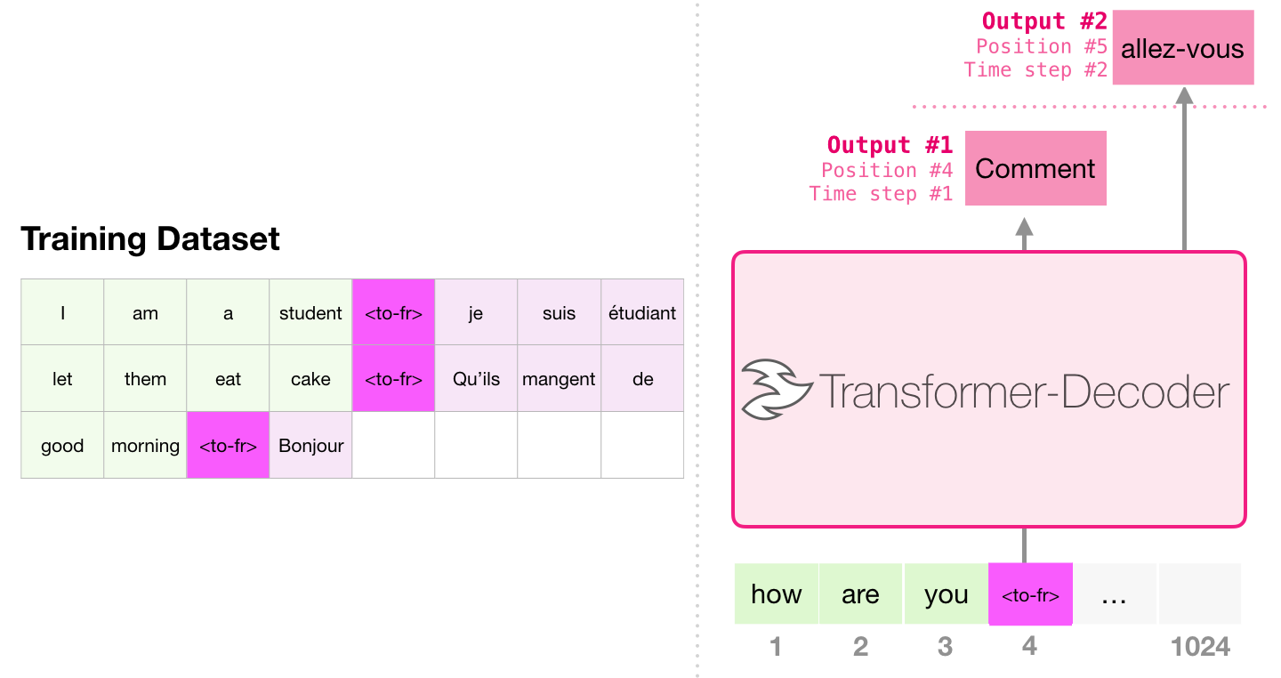
Example: Machine Translation
An encoder is not required to conduct translation

Slide 17
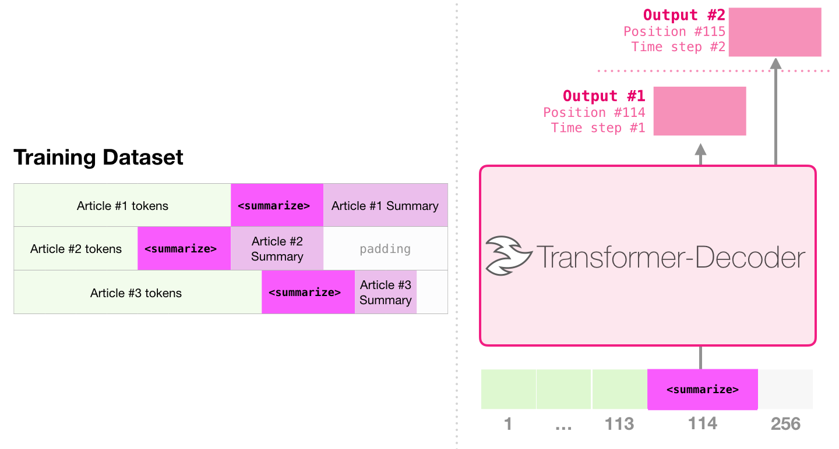
Examples: Summarization

Slide 18
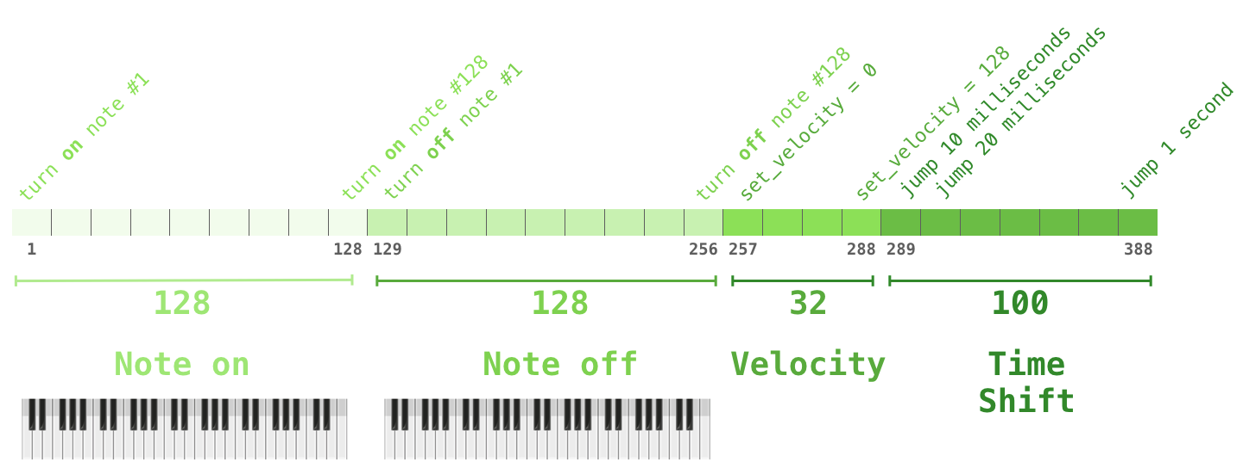
Examples: Music Generation

Slide 19
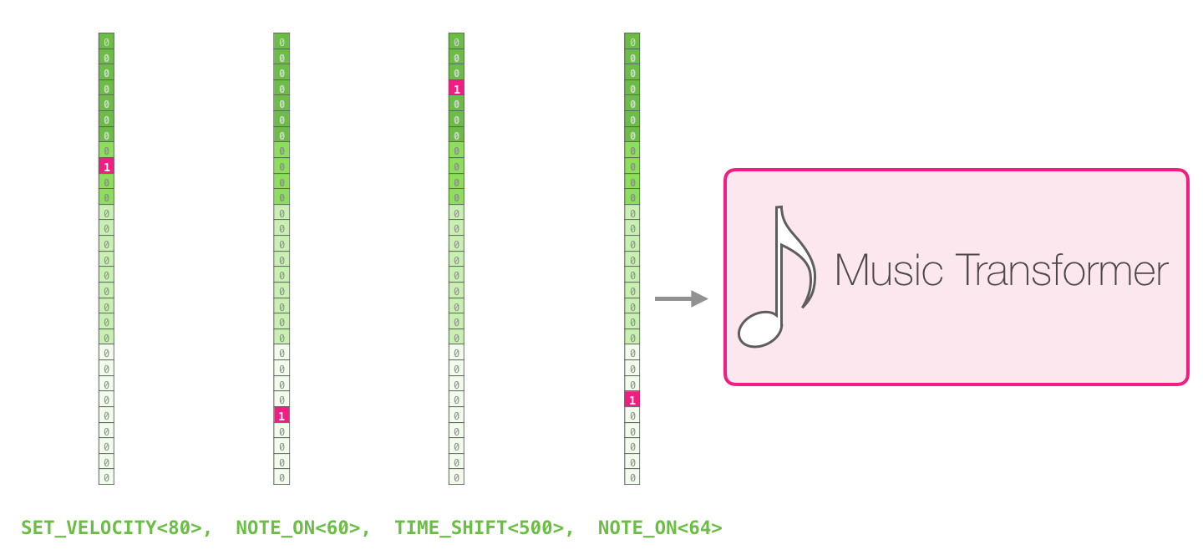
Examples: Music Generation

Slide 20
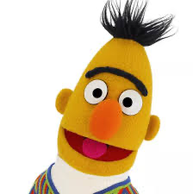
BERT: Bidirectional Encoder Representation from Transformer

Slide 21
BERT

Slide 22
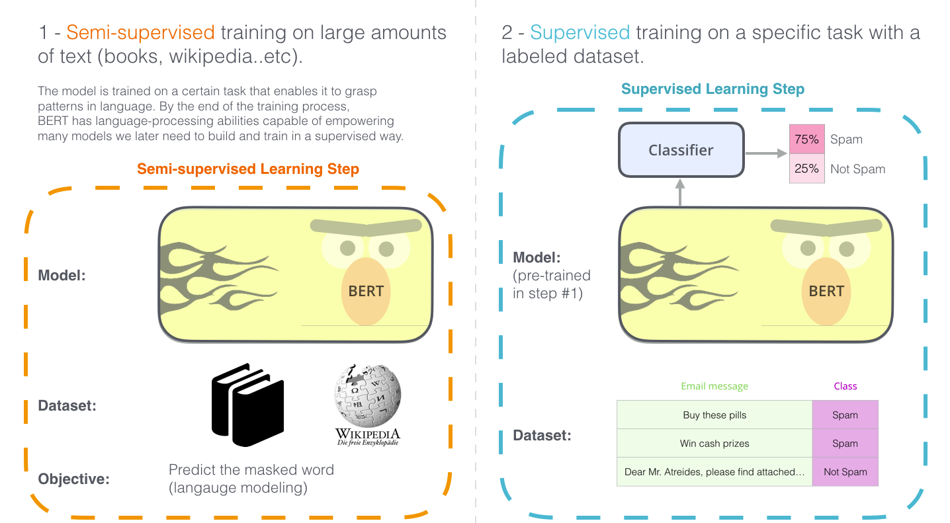
BERT

Slide 23
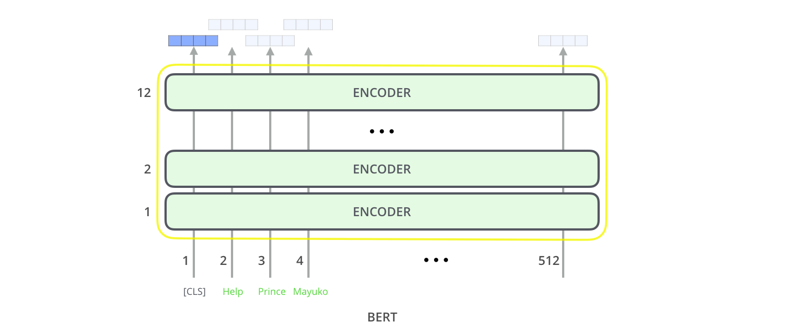
BERT

Slide 24
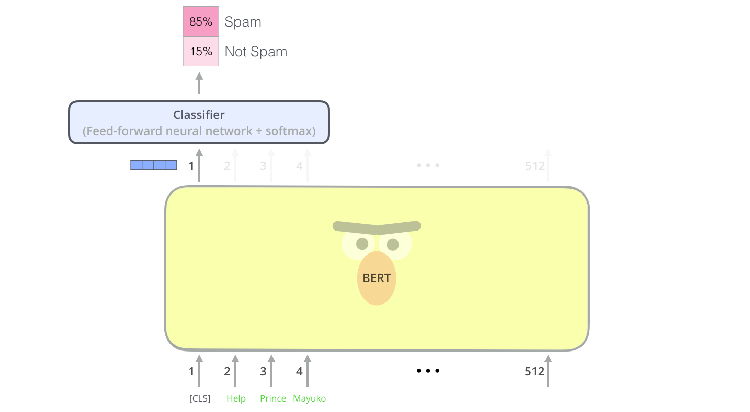
BERT

Slide 25
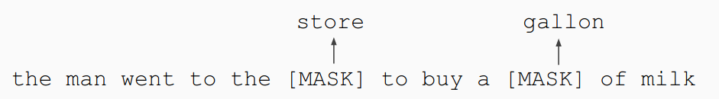
BERT pretraining: Masked Language Model
Solution: Mask out k% of the input words, and then predict the masked words
Too little masking: Too expensive to train
Too much masking: Not enough context

Slide 26
BERT pretraining: Masked Language Model
Problem: Mask token never seen at fine-tuning
Solution: 15% of the words to predict, but don’t replace with [MASK] 100% of the time. Instead:
80% of the time, replace with [MASK]
went to the store → went to the [MASK]
● 10% of the time, replace random word
went to the store → went to the running
● 10% of the time, keep same
went to the store → went to the store

Slide 27
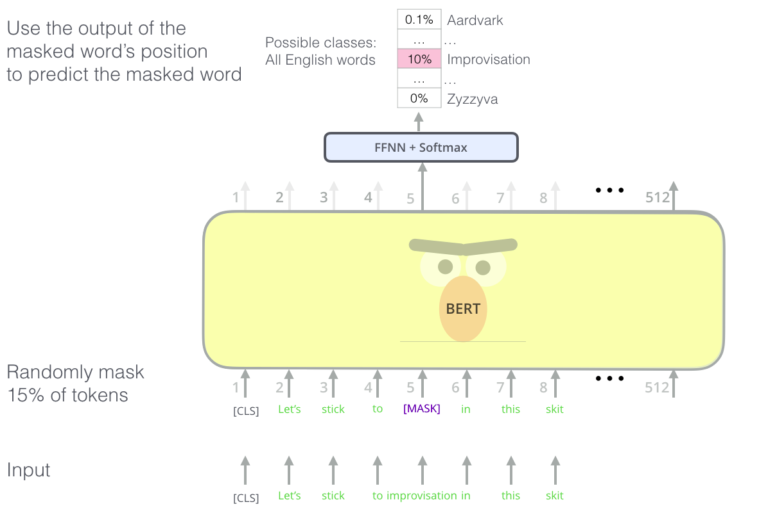
BERT pretraining: Masked Language Model

Slide 28

BERT pretraining: Next Sentence Prediction
To learn relationships between sentences, predict whether Sentence B is actual sentence that proceeds Sentence A, or a random sentence

Slide 29
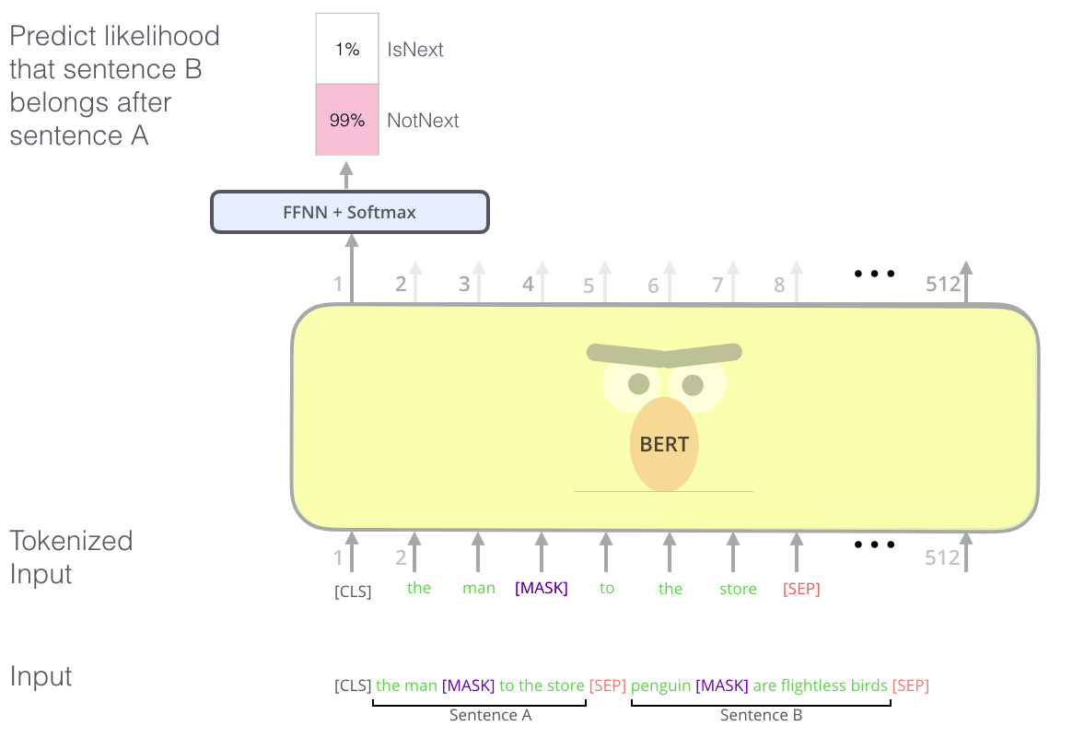
BERT pretraining: Next Sentence Prediction

Slide 30
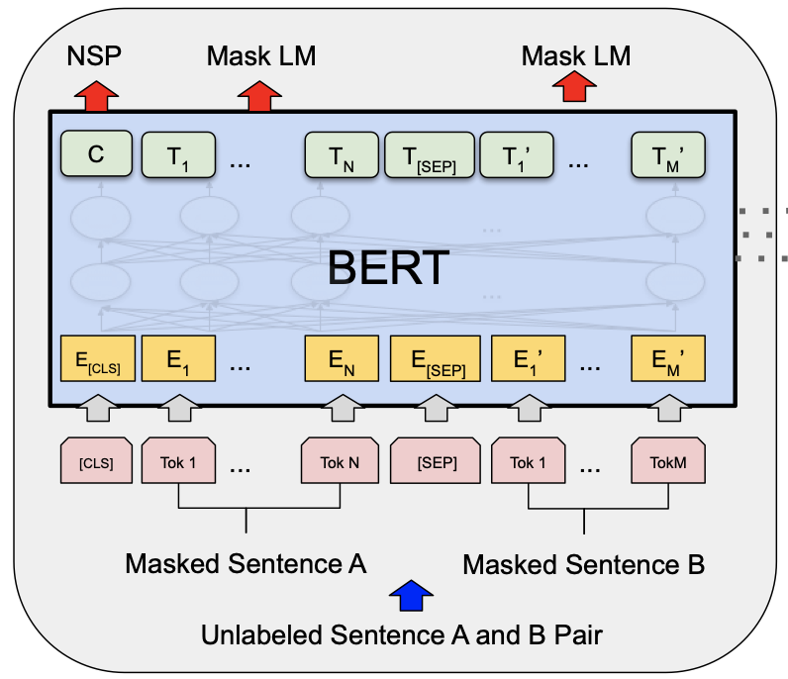
BERT pretraining

Slide 31
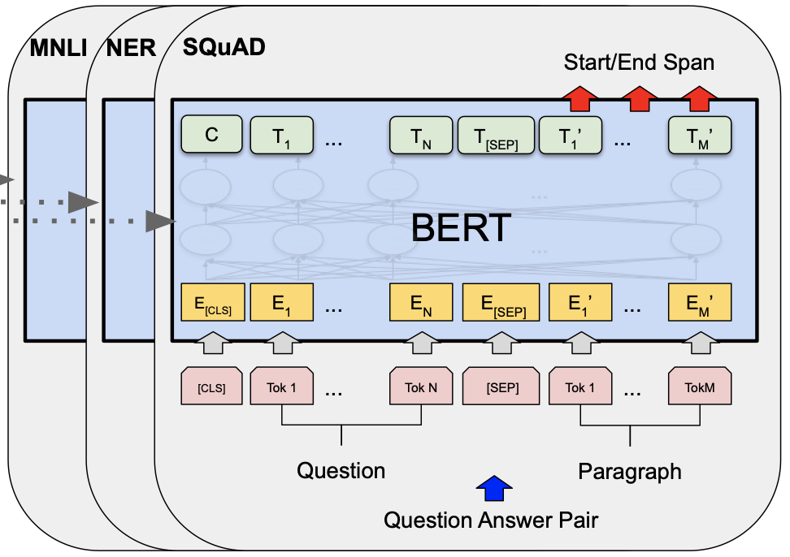
BERT: fine-tuning

Slide 32
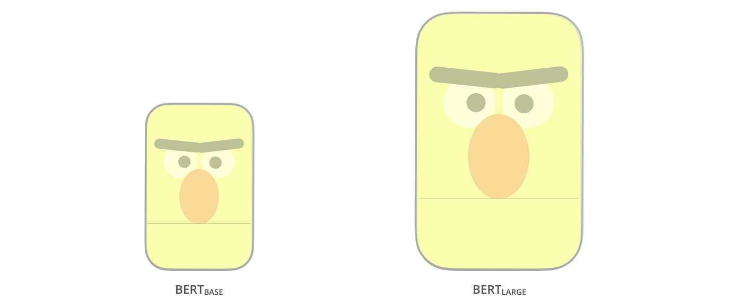
BERT

Slide 33
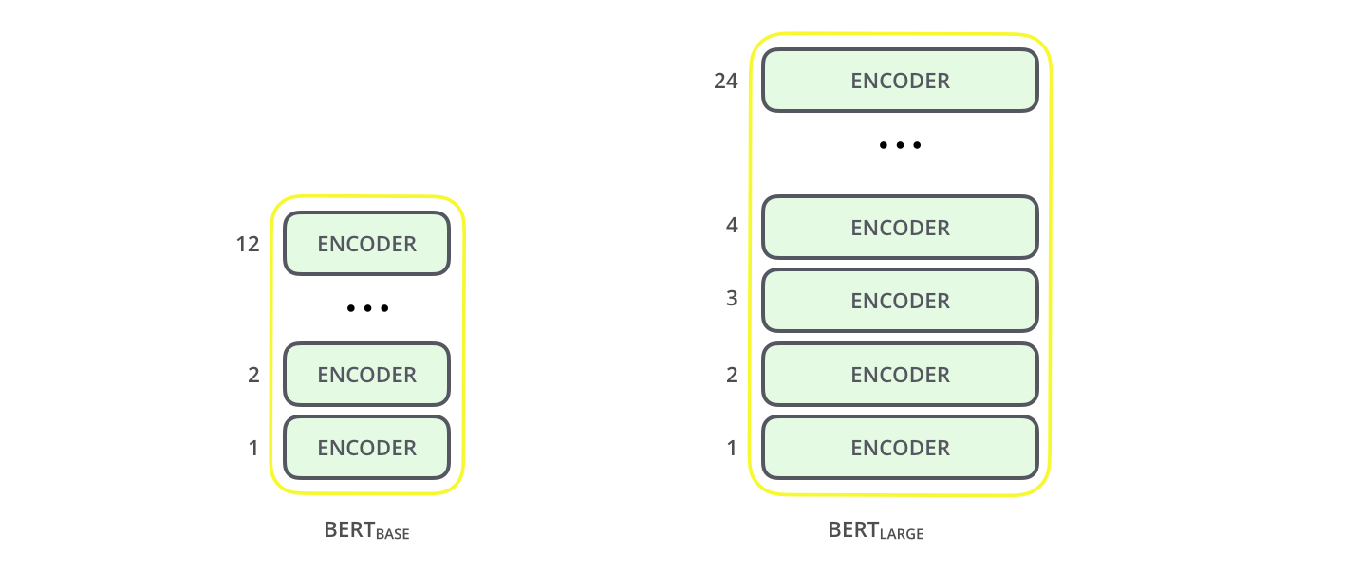
BERT
768 and 1024 hidden units
attention heads 12 and 16
default Transformer configuration:
6 encoder layers, 512 hidden units, 8 attention head

Slide 34
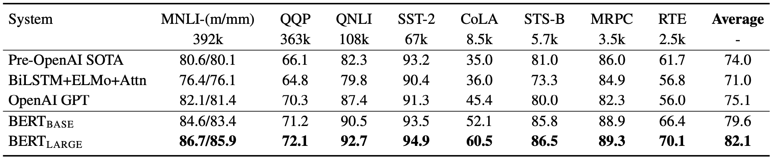
BERT

Slide 35
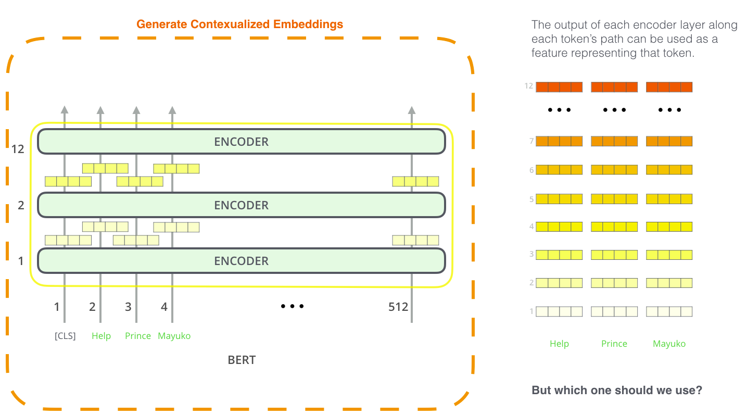
BERT: feature extraction

Slide 36
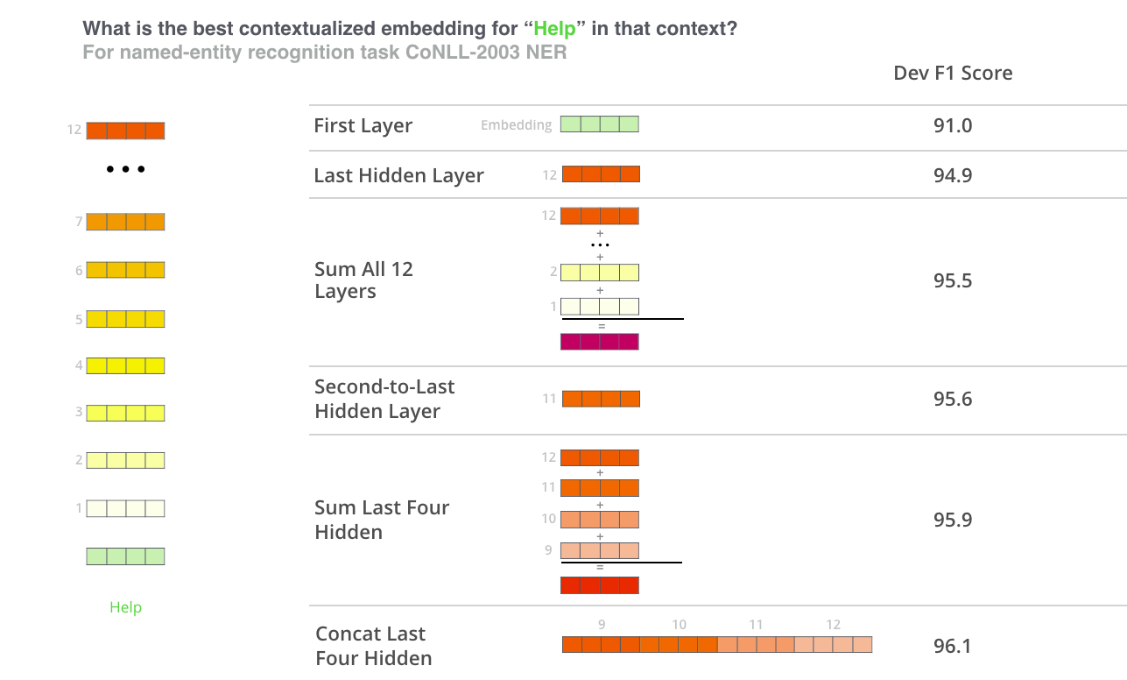
BERT: feature extraction

